Slide 1
3D Human Modeling
Group:
Vigneshwar Muriki
Veda Samhitha Dyawanapally
Mounika Kasaragadda
Deepthi Gade

Slide 2
Chosen Project
3D Human Modeling (Digi Human – Animate Avatar)
A physical body is represented by three-dimensional (3D) models using a network of points connected by various geometrical objects like triangles, lines, curved surfaces, etc. The process of creating three-dimensional representations of an object or surface is known as three-dimensional modeling. A detailed and accurate 3D model of a human body is what is intended by 3D human modeling.
Can used for a variety of applications, including animation, video games, virtual reality, and human-computer interaction.
Objective:
Generates whole Body pose animation as well as facial animation.
Developed using Media pipe and Unity3D.
Media pipe generates 3D landmarks and Unity3D renders final animation.

Slide 3
Iteration 1
Objective: Create a simple web app to understand the WebRTC Protocols.
Procedure:
Create a basic HTML file and add necessary structure to the page.
Include necessary JavaScript libraries for the WebRTC functionality.
Create a user interface to add buttons, textboxes etc.
Set up WebRTC Connection between client and server. This involves creating RTC peer connection object, setting up remote descriptions and add event listeners for the WebRTC events such as “ice candidate” and “track”
Configure data and video channels. Data channel is used to send messages and video channel is used to transmit video and audio data.

Slide 4
WebRTC APIs
WebRTC consists of several interrelated APIs and protocols which work together to achieve Real Time Communication. The most important APIs that we will use in this tutorial series:
getUserMedia( ) : capture audio and video.
MediaRecorder: record audio and video.
RTCPeerConnection: stream audio and video between users.
RTCDataChannel: stream data between users.

Slide 5
Requirements
We have used the following:-
Node.Js (version 12.14.1) — Runtime Env for JS
Socket.IO (version 1.2.0) — for signaling in WebRTC
Express.Js: (version 4.17.1) — Back End Framework
Code Editor (We used Microsoft Visual Studio Code)
A Good Browser (We used Google Chrome)

Slide 6
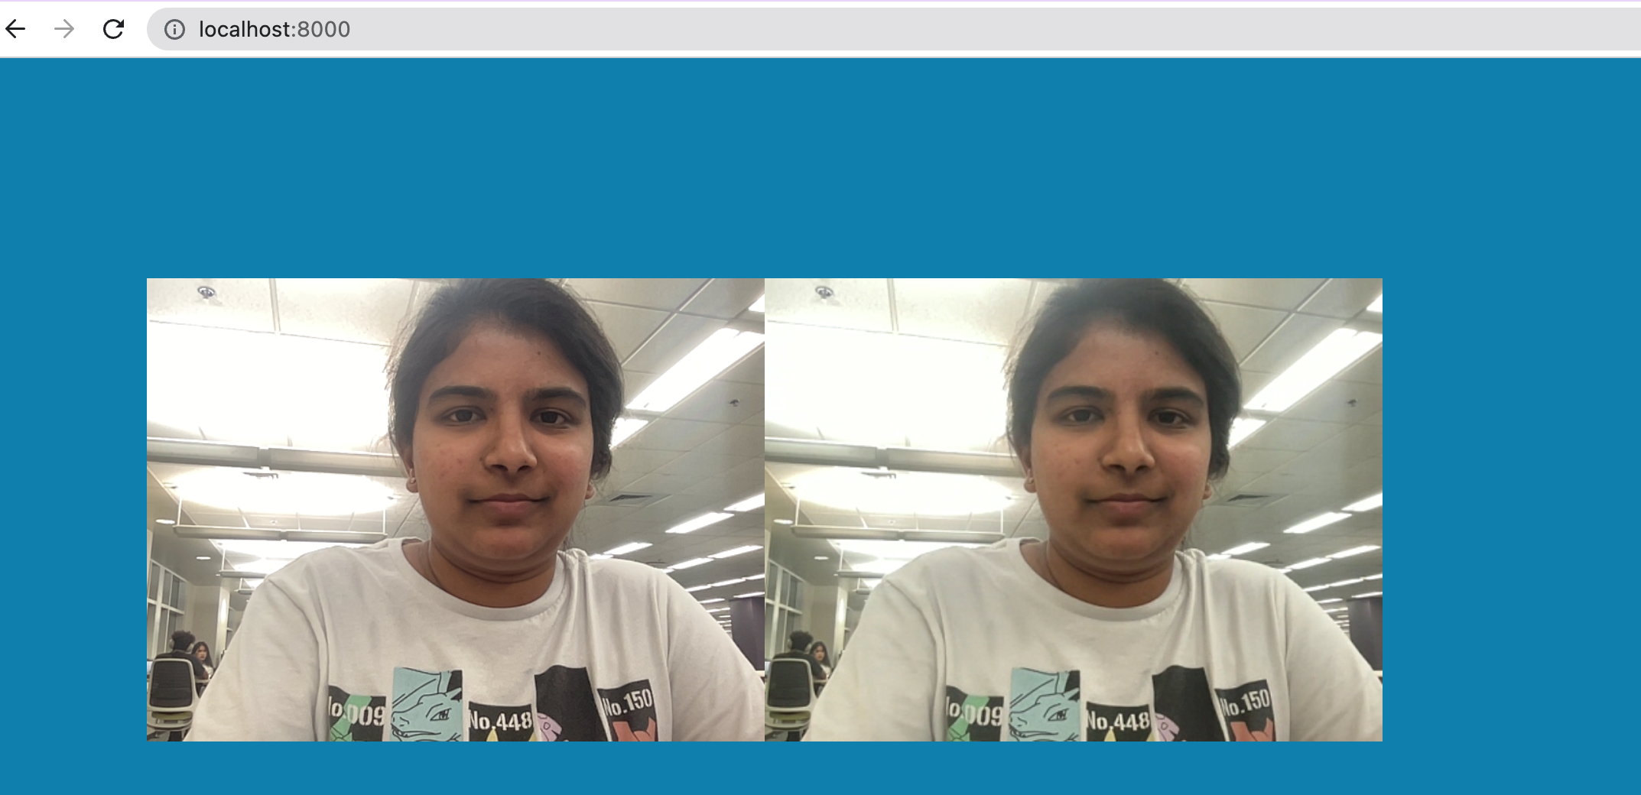
Screenshot:
Display video stream using JavaScript from the remote user in the browser.
Using data channel to send and receive messages.
Testing the application by opening it in two different browsers or devices.

Slide 7
Iteration 2
To enable real time communication using WebRTC in a 3D Human model deployed using WebGL in Unity
Adding WebRTC functionality to the Unity Project
Establish WebRTC connection using signaling server to exchange SDP messages between client and server
Configure WebRTC data and video channels
Encode and transmit the 3D Human Model
On the receiving end 3D Human model is decoded and rendered in real-time using WebGL. This allows users to see the 3D model and interact with it in real-time

Slide 8
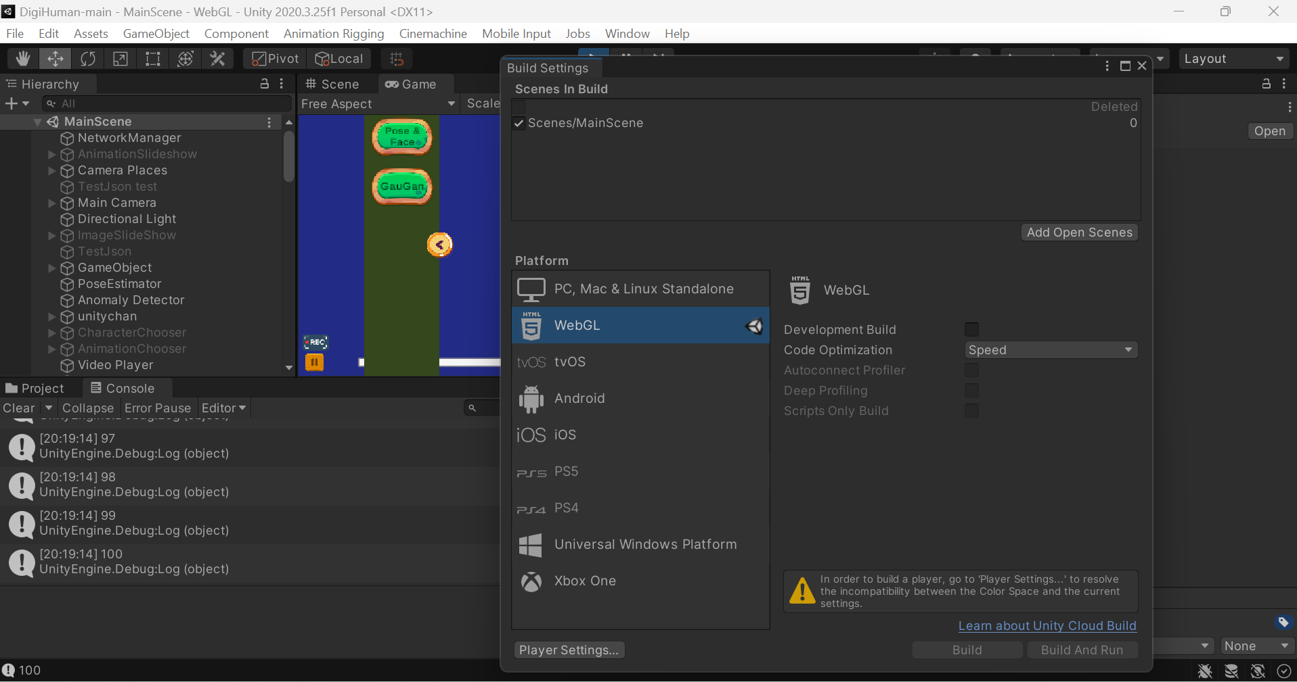
Screenshot:

Slide 9

Thank You

